Slide 1
The Apocalypse of Jesus

Slide 2
Commentaries to Use
Bible, New American, Revised Edition
Catholic Commentary on Scripture Series: Revelation, Peter S. Williamson, Nook/kindle editions
The Navarre Bible Series: Revelation and Hebrews and Catholic Letters, University of Navarre
Anchor Bible Series: Revelation, J. Massyngberde Ford
Ancient Christian Commentary on Scripture, volume XII, William C. Weinrich, Ed., 2005, Inter Varsity Press
Ancient Christian Texts, Greek Commentaries on Revelation, Weinrich, 2011 Inter Varsity Press
Ancient Christian Texts, Latin Commentaries on Revelation, Weinrich, 2011 Inter Varsity Press
New Jerome Biblical Commentary, (one volume), Raymond E. Brown et al, 1988
Comentario Bíblico Internacional, William R. Farmer et al, Liturgical Press, Collegeville, 1998
International Bible Commentary (see above)

Slide 3
Author and Context
John, exiled to Patmos, witness of the message
The apostle John? Another John? Hay dos hombres se llamaron Juan honrado en Éfeso
Gives testimony to what he has seen, what is and what Will come
Expectation (hope) that the book Will be READ IN COMMUNITY (at Mass):
A blessing offered to those who read and one offered to those who hear
To the Seven churches in Asia (minor), which is to say, the ENTIRE church
Author knows the Old Testament very well, better than any other New Testament autor and refers to the Old Testament more often than any other New Testament book
Is a prophet, but does not prophesy. In line of great prophets, calls to conversion
Written about? 96AD, 66AD, 150AD
Probably 96AD
Well known and referred to by many of the ancient Church Fathers.

Slide 4
Definitions
Apocalypse: a manifestation, literally “to remove the veil”, the end of everything
Ecstasy: “caught up in the spirit”, to feel the holy Spirit, literally “outside (or away from) of oneself/one’s body
Spirits: the manifestation of the same Holy Spirit in parts, as in the “gifts”
The Lord’s Day: Sunday, when the Christian community celebrated the Eucharist (1st time used)
Alfa and Omega: first and last letters of the Greek alphabet; the beginning and the end
simile and metaphor: ways of comparing or symbolizing an idea
Patmos: a Greek island used as a Roman penal colony

Slide 5
Structure of Book
Introduction
The Eschatological Vision
First Part
Christ opens the 7 seals
The Great Multitude of those Saved
The 7th seal – The Trumpets
The Scroll to eat
The death and Resurrection of 2 witnesses

Slide 6
Structure of Book
The Second Part
The 7th Tumpet
The Woman Pursued by the Dragon
The beasts receive authority
The Lamb and His Companions
Proclamation of Judgment & Hymns
7 bowls of plagues
Description of the Evil
Fall of Babylon
Songs of Victory
1st Battle
Reign of 1,000 years of Christ
2nd battle
The Final Judgment
A New World Arrives
Conclusion

Slide 7
Symbols of Book
Numbers: 3; 4; 6; 7; 8; 12; 1.000; 12.000; 144.000
7 Spirits
7 Stars
7 Lampstands
7 Churches
7 Bowls
The Beast
The Woman and the Dragon

Slide 8
Teachings of the Book
God All-powerful
Jesus Christ
The Holy Spirit(s)
The Church
Angels
The Virgin Mary
The New Creation (not in commentary, I added it as essential teaching for Catholics)

Slide 9
Symbols of Book
Numbers: 3; 4; 6; 7; 8; 12; 1.000; 12.000; 144.000
7 Spirits
7 Stars
7 Lampstands
7 Churches
7 Bowls
The Beast
The Woman and the Dragon

Slide 10
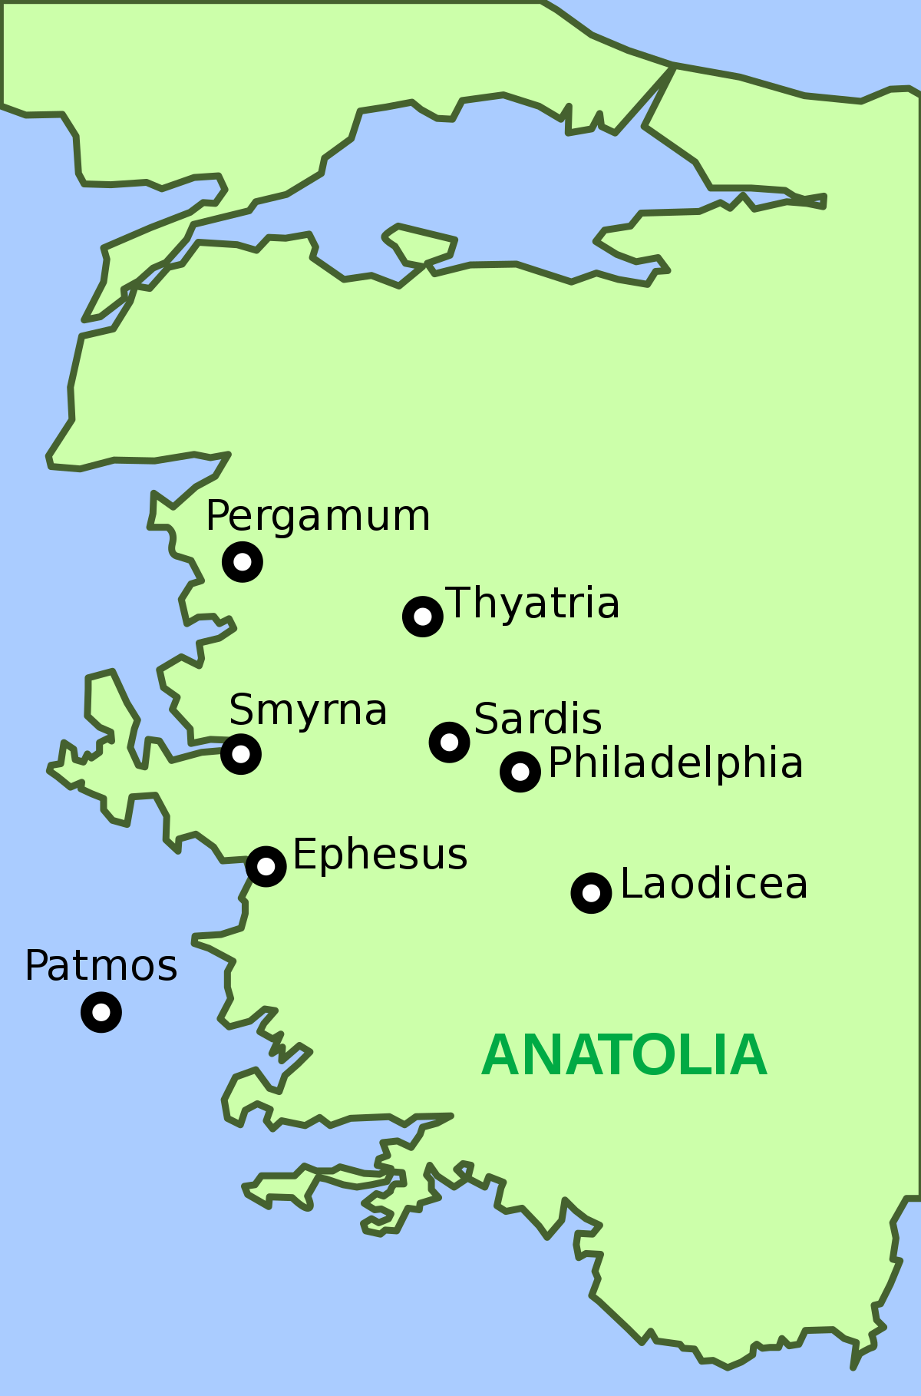

Slide 11
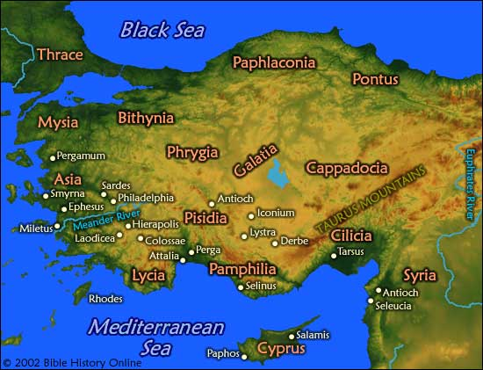

Slide 12
Chapter 1
1The revelation of Jesus Christ, which God gave to him, to show his servants what must happen soon. He made it known by sending his angel to his servant John, 2who gives witness to the word of God and to the testimony of Jesus Christ by reporting what he saw. 3Blessed is the one who reads aloud and blessed are those who listen to this prophetic message and heed what is written in it, for the appointed time is near.
II. LETTERS TO THE CHURCHES OF ASIA
Greeting. 4John, to the seven churches in Asia: grace to you and peace from him who is and who was and who is to come, and from the seven spirits before his throne, 5and from Jesus Christ, the faithful witness, the firstborn of the dead and ruler of the kings of the earth. To him who loves us and has freed us from our sins by his blood, 6who has made us into a kingdom, priests for his God and Father, to him be glory and power forever [and ever]. Amen.
7Behold, he is coming amid the clouds,
and every eye will see him,
even those who pierced him.
All the peoples of the earth will lament him.
Yes. Amen.
8“I am the Alpha and the Omega,” says the Lord God, “the one who is and who was and who is to come, the almighty.”

Slide 13
The First Vision. 9I, John, your brother, who share with you the distress, the kingdom, and the endurance we have in Jesus, found myself on the island called Patmos because I proclaimed God’s word and gave testimony to Jesus. 10I was caught up in spirit on the Lord’s day and heard behind me a voice as loud as a trumpet, 11which said, “Write on a scroll what you see and send it to the seven churches: to Ephesus, Smyrna, Pergamum, Thyatira, Sardis, Philadelphia, and Laodicea.” 12 Then I turned to see whose voice it was that spoke to me, and when I turned, I saw seven gold lampstands 13and in the midst of the lampstands one like a son of man, wearing an ankle-length robe, with a gold sash around his chest. 14The hair of his head was as white as white wool or as snow, and his eyes were like a fiery flame. 15His feet were like polished brass refined in a furnace, and his voice was like the sound of rushing water. 16In his right hand he held seven stars. A sharp two-edged sword came out of his mouth, and his face shone like the sun at its brightest.
17When I caught sight of him, I fell down at his feet as though dead. He touched me with his right hand and said, “Do not be afraid. I am the first and the last, 18the one who lives. Once I was dead, but now I am alive forever and ever. I hold the keys to death and the netherworld. 19Write down, therefore, what you have seen, and what is happening, and what will happen afterwards. 20This is the secret meaning of the seven stars you saw in my right hand, and of the seven gold lampstands: the seven stars are the angels of the seven churches, and the seven lampstands are the seven churches.

Slide 14
FORMAT OF THE LETTERS TO THE CHURCHES OF ASIA
Greeting: To the angel of the church of ...
Presentation of an image of Christ according to the vision (“the one who holds the seven starts in his hand”)
The condition of the Church (“I know ...”)
Specific Exhortation to each church, an evaluation
General Exhortation to listen to what the Spirit says to all the churches
Promise to the “Victor” in relation to final salvation

Slide 15
Chapter 2
To Ephesus. 1 “To the angel of the church in Ephesus, write this:
“‘The one who holds the seven stars in his right hand and walks in the midst of the seven gold lampstands says this: 2“I know your works, your labor, and your endurance, and that you cannot tolerate the wicked; you have tested those who call themselves apostles but are not, and discovered that they are impostors. 3Moreover, you have endurance and have suffered for my name, and you have not grown weary. 4Yet I hold this against you: you have lost the love you had at first. 5Realize how far you have fallen. Repent, and do the works you did at first. Otherwise, I will come to you and remove your lampstand from its place, unless you repent. 6But you have this in your favor: you hate the works of the Nicolaitans, which I also hate.
7“‘“Whoever has ears ought to hear what the Spirit says to the churches. To the victor I will give the right to eat from the tree of life that is in the garden of God.”’
To Smyrna. 8“To the angel of the church in Smyrna, write this:
“‘The first and the last, who once died but came to life, says this: 9“I know your tribulation and poverty, but you are rich. I know the slander of those who claim to be Jews and are not, but rather are members of the assembly of Satan. 10Do not be afraid of anything that you are going to suffer. Indeed, the devil will throw some of you into prison, that you may be tested, and you will face an ordeal for ten days. Remain faithful until death, and I will give you the crown of life.
11“‘“Whoever has ears ought to hear what the Spirit says to the churches. The victor shall not be harmed by the second death.”’

Slide 16
To Pergamum. 12“To the angel of the church in Pergamum, write this:
“‘The one with the sharp two-edged sword says this: 13“I know that you live where Satan’s throne is, and yet you hold fast to my name and have not denied your faith in me, not even in the days of Antipas, my faithful witness, who was martyred among you, where Satan lives. 14 Yet I have a few things against you. You have some people there who hold to the teaching of Balaam, who instructed Balak to put a stumbling block before the Israelites: to eat food sacrificed to idols and to play the harlot. 15Likewise, you also have some people who hold to the teaching of [the] Nicolaitans. 16Therefore, repent. Otherwise, I will come to you quickly and wage war against them with the sword of my mouth.
17“‘“Whoever has ears ought to hear what the Spirit says to the churches. To the victor I shall give some of the hidden manna; I shall also give a white amulet upon which is inscribed a new name, which no one knows except the one who receives it.”’

Slide 17
To Thyatira. 18“To the angel of the church in Thyatira, write this:
“‘The Son of God, whose eyes are like a fiery flame and whose feet are like polished brass, says this: 19“I know your works, your love, faith, service, and endurance, and that your last works are greater than the first. 20Yet I hold this against you, that you tolerate the woman Jezebel, who calls herself a prophetess, who teaches and misleads my servants to play the harlot and to eat food sacrificed to idols. 21I have given her time to repent, but she refuses to repent of her harlotry. 22So I will cast her on a sickbed and plunge those who commit adultery with her into intense suffering unless they repent of her works. 23I will also put her children to death. Thus shall all the churches come to know that I am the searcher of hearts and minds and that I will give each of you what your works deserve. 24But I say to the rest of you in Thyatira, who do not uphold this teaching and know nothing of the so-called deep secrets of Satan: on you I will place no further burden, 25except that you must hold fast to what you have until I come.
26“‘“To the victor, who keeps to my ways until the end,
I will give authority over the nations.
27He will rule them with an iron rod.
Like clay vessels will they be smashed,
28just as I received authority from my Father. And to him I will give the morning star.
29“‘“Whoever has ears ought to hear what the Spirit says to the churches.”’

Slide 18
Chapter 3
To Sardis. 1“To the angel of the church in Sardis, write this:
“‘The one who has the seven spirits of God and the seven stars says this: “I know your works, that you have the reputation of being alive, but you are dead. 2Be watchful and strengthen what is left, which is going to die, for I have not found your works complete in the sight of my God. 3Remember then how you accepted and heard; keep it, and repent. If you are not watchful, I will come like a thief, and you will never know at what hour I will come upon you. 4However, you have a few people in Sardis who have not soiled their garments; they will walk with me dressed in white, because they are worthy.
5“‘“The victor will thus be dressed in white, and I will never erase his name from the book of life but will acknowledge his name in the presence of my Father and of his angels.
6“‘“Whoever has ears ought to hear what the Spirit says to the churches.”’

Slide 19
To Philadelphia. 7“To the angel of the church in Philadelphia, write this:
“‘The holy one, the true,
who holds the key of David,
who opens and no one shall close,
who closes and no one shall open,
says this:
8“‘“I know your works (behold, I have left an open door before you, which no one can close). You have limited strength, and yet you have kept my word and have not denied my name. 9Behold, I will make those of the assembly of Satan who claim to be Jews and are not, but are lying, behold I will make them come and fall prostrate at your feet, and they will realize that I love you. 10Because you have kept my message of endurance, I will keep you safe in the time of trial that is going to come to the whole world to test the inhabitants of the earth. 11I am coming quickly. Hold fast to what you have, so that no one may take your crown.
12“‘“The victor I will make into a pillar in the temple of my God, and he will never leave it again. On him I will inscribe the name of my God and the name of the city of my God, the new Jerusalem, which comes down out of heaven from my God, as well as my new name.
13“‘“Whoever has ears ought to hear what the Spirit says to the churches.”’

Slide 20
To Laodicea. 14“To the angel of the church in Laodicea, write this:
“‘The Amen, the faithful and true witness, the source of God’s creation, says this: 15“I know your works; I know that you are neither cold nor hot. I wish you were either cold or hot. 16 So, because you are lukewarm, neither hot nor cold, I will spit you out of my mouth. 17 For you say, ‘I am rich and affluent and have no need of anything,’ and yet do not realize that you are wretched, pitiable, poor, blind, and naked. 18I advise you to buy from me gold refined by fire so that you may be rich, and white garments to put on so that your shameful nakedness may not be exposed, and buy ointment to smear on your eyes so that you may see. 19Those whom I love, I reprove and chastise. Be earnest, therefore, and repent.
20“‘“Behold, I stand at the door and knock. If anyone hears my voice and opens the door, [then] I will enter his house and dine with him, and he with me. 21I will give the victor the right to sit with me on my throne, as I myself first won the victory and sit with my Father on his throne.
22“‘“Whoever has ears ought to hear what the Spirit says to the churches.”’”

Slide 21
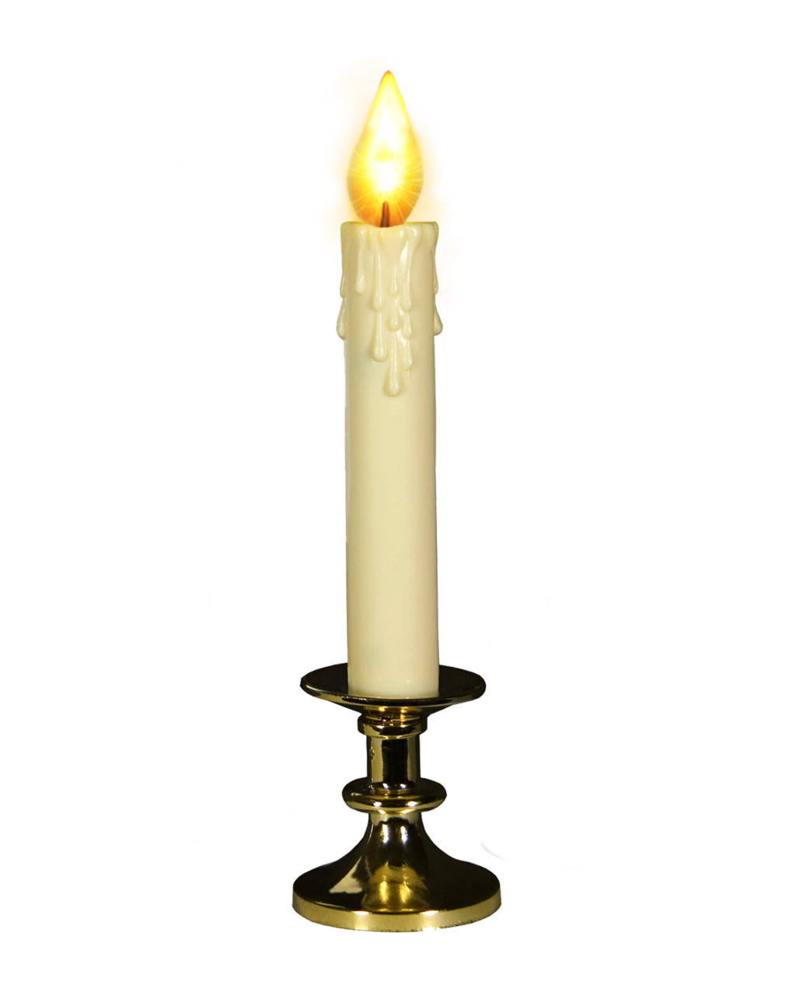
Ephesus
Smyrna
Pergamum
Thyratira
Sardis
Philadelphia
Laodicea
GREETING | Who holds the 7 stars in his hand | Speaks the 1st and the Last, I was dead, but now I have come back to Life | Who holds the sharp, 2 edged sword | Son of God Eyes like fiery flame, Feet like polished Brass | 7 Spirits 7 Stars | The holy, the True, the one who guards the keys of David | The Amen, The Faithful Witness, The Truth, The Beginning
VIRTUES | Works, suffering difficulties, perseverance, tests claims to be apostles | You suffer and are poor, but you are rich | Live where Satan’s throne is, yet you hold fast and have not denied your faith | I know your works, faith, love, service, last works are greater than the first |  | I have opened a door, You have not denied me
PROBLEMS | You have lost the love you previously had |  | You tolerate those who teach false doctrines | tolerate the woman Jezebel, You eat food sacrificed to Idols | You think you are alive, but you are dead |  | You are neither hot nor cold, I am rich and lack nothing
EXHORTATION | From where you have fallen, recover yourself | Do not be afraid of what you must suffer | I will come quickly to combat these people | Do not share in their false teachings | Remember what you have received and heard | Remain firm in what you have | Buy from me refined gold, I stand at the door and knock
THE VICTOR WILL RECEIVE | Will eat from the Tree of Life | Have no fear of the 2nd death | mysterious manna, white stone | Power over the nations | Name will not be removed from book of Life | Place you as a column in God’s Temple | Will be seated with me on my throne

Slide 22
Chapter 4
Vision of Heavenly Worship. 1After this I had a vision of an open door to heaven, and I heard the trumpetlike voice that had spoken to me before, saying, “Come up here and I will show you what must happen afterwards.” 2 At once I was caught up in spirit. A throne was there in heaven, and on the throne sat 3one whose appearance sparkled like jasper and carnelian. Around the throne was a halo as brilliant as an emerald. 4Surrounding the throne I saw twenty-four other thrones on which twenty-four elders sat, dressed in white garments and with gold crowns on their heads. 5From the throne came flashes of lightning, rumblings, and peals of thunder. Seven flaming torches burned in front of the throne, which are the seven spirits of God. 6 In front of the throne was something that resembled a sea of glass like crystal.
In the center and around the throne, there were four living creatures covered with eyes in front and in back. 7The first creature resembled a lion, the second was like a calf, the third had a face like that of a human being, and the fourth looked like an eagle in flight. 8The four living creatures, each of them with six wings, were covered with eyes inside and out. Day and night they do not stop exclaiming:
“Holy, holy, holy is the Lord God almighty,
who was, and who is, and who is to come.”
9Whenever the living creatures give glory and honor and thanks to the one who sits on the throne, who lives forever and ever, 10the twenty-four elders fall down before the one who sits on the throne and worship him, who lives forever and ever. They throw down their crowns before the throne, exclaiming:
11“Worthy are you, Lord our God,
to receive glory and honor and power,
for you created all things;
because of your will they came to be and were created.”

Slide 23
Chapter 5
The Scroll and the Lamb. 1I saw a scroll in the right hand of the one who sat on the throne. It had writing on both sides and was sealed with seven seals. 2Then I saw a mighty angel who proclaimed in a loud voice, “Who is worthy to open the scroll and break its seals?” 3But no one in heaven or on earth or under the earth was able to open the scroll or to examine it. 4I shed many tears because no one was found worthy to open the scroll or to examine it. 5One of the elders said to me, “Do not weep. The lion of the tribe of Judah, the root of David, has triumphed, enabling him to open the scroll with its seven seals.”
6Then I saw standing in the midst of the throne and the four living creatures and the elders a Lamb that seemed to have been slain. He had seven horns and seven eyes; these are the [seven] spirits of God sent out into the whole world. 7He came and received the scroll from the right hand of the one who sat on the throne. 8When he took it, the four living creatures and the twenty-four elders fell down before the Lamb. Each of the elders held a harp and gold bowls filled with incense, which are the prayers of the holy ones. 9They sang a new hymn:
“Worthy are you to receive the scroll
and to break open its seals,
for you were slain and with your blood you purchased for God
those from every tribe and tongue, people and nation.
10You made them a kingdom and priests for our God,
and they will reign on earth.”

Slide 24
11I looked again and heard the voices of many angels who surrounded the throne and the living creatures and the elders. They were countless in number, 12and they cried out in a loud voice:
“Worthy is the Lamb that was slain
to receive power and riches, wisdom and strength,
honor and glory and blessing.”
13Then I heard every creature in heaven and on earth and under the earth and in the sea, everything in the universe, cry out:
“To the one who sits on the throne and to the Lamb
be blessing and honor, glory and might,
forever and ever.”
14The four living creatures answered, “Amen,” and the elders fell down and worshiped.
Chapter 6
The First Six Seals. 1 Then I watched while the Lamb broke open the first of the seven seals, and I heard one of the four living creatures cry out in a voice like thunder, “Come forward.” 2I looked, and there was a white horse, and its rider had a bow. He was given a crown, and he rode forth victorious to further his victories.
3When he broke open the second seal, I heard the second living creature cry out, “Come forward.” 4 Another horse came out, a red one. Its rider was given power to take peace away from the earth, so that people would slaughter one another. And he was given a huge sword.

Slide 25
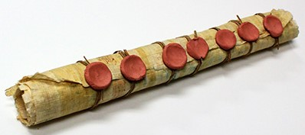
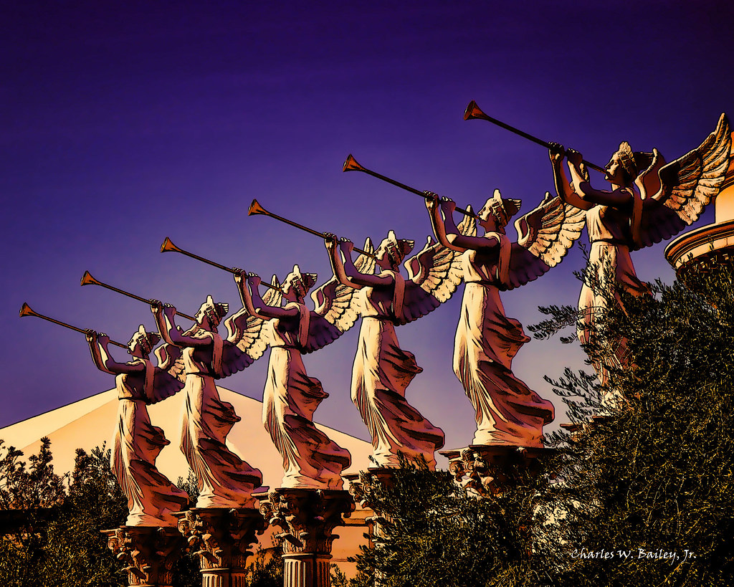
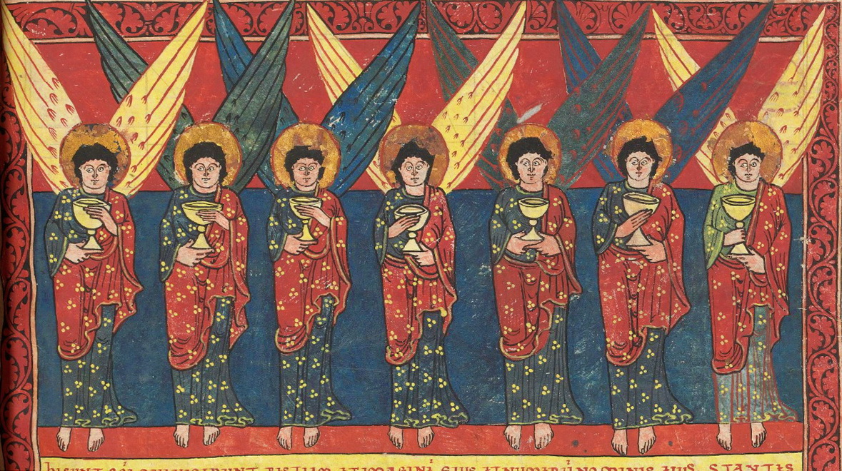
1st 2nd 3rd 4th 5th 6th 7th
The Four “Horsemen” of the Apocalypse
SEALS | white horse, rider with bow given a crown to further his victories | fiery red horse, rider given power to take peace away; people slaughter one another | black horse, rider held a scale ration of wheat & barley; do no harm to olives or wine | pale green horse, rider named death, Hades at its side authority over ¼ of earth to kill sword, famine, plague | underneath the altar the souls of the slaughtered, given white robes and told to wait for the rest of those to give witness | great earthquake, sun turned black, moon became like blood; all powerful cry out in fear | SILENCE ½ hour 7 angels given 7 trumpets gold censer with incense to rise as prayers, censer hurled down to earth
TRUMPETS | hail & fire mixed with blood; 1/3 land, trees, grass burned | burning mountain hurled into sea turning it to blood; 1/3 of sea creatures and ships destroyed | large star “Wormwood” burning like torch fell on rivers & springs and water turned to wormwood made bitter | third of sun, moon, stars became dark; day lost third of light; eagle cries “Woe, woe, woe” | Star fell, abyss opened, locusts came up to harm those without seal of God for 5 months | Release 4 angels bound at banks of Euphrates, 1/3 of humans killed, Plagues: fire, smoke, sulfur | The Kingdom of the world now belongs to our Lord and his Anointed and he will reign forever
BOWLS | Sores on those with mark of beast | Sea turns to blood, all sea creatures die | Rivers and springs turn to blood | On the sun, power to burn people with fire, blasphemers burned | on throne of beast its kingdom in darkness, people bit their tongues and blasphemed | on Euphrates, dries up, unclean spirits come out like frogs from mouth of beast | into air; it is done lightning flashes, earthquake, great city split in 3, wine of wrath, hailstones
This Photo by Unknown Author is licensed under CC BY-NC

Slide 26
5When he broke open the third seal, I heard the third living creature cry out, “Come forward.” I looked, and there was a black horse, and its rider held a scale in his hand. 6I heard what seemed to be a voice in the midst of the four living creatures. It said, “A ration of wheat costs a day’s pay, and three rations of barley cost a day’s pay. But do not damage the olive oil or the wine.”
7When he broke open the fourth seal, I heard the voice of the fourth living creature cry out, “Come forward.” 8I looked, and there was a pale green horse. Its rider was named Death, and Hades accompanied him. They were given authority over a quarter of the earth, to kill with sword, famine, and plague, and by means of the beasts of the earth.
9When he broke open the fifth seal, I saw underneath the altar the souls of those who had been slaughtered because of the witness they bore to the word of God. 10They cried out in a loud voice, “How long will it be, holy and true master, before you sit in judgment and avenge our blood on the inhabitants of the earth?” 11Each of them was given a white robe, and they were told to be patient a little while longer until the number was filled of their fellow servants and brothers who were going to be killed as they had been.
12 Then I watched while he broke open the sixth seal, and there was a great earthquake; the sun turned as black as dark sackcloth and the whole moon became like blood. 13The stars in the sky fell to the earth like unripe figs shaken loose from the tree in a strong wind. 14Then the sky was divided like a torn scroll curling up, and every mountain and island was moved from its place. 15The kings of the earth, the nobles, the military officers, the rich, the powerful, and every slave and free person hid themselves in caves and among mountain crags. 16They cried out to the mountains and the rocks, “Fall on us and hide us from the face of the one who sits on the throne and from the wrath of the Lamb, 17because the great day of their wrath has come and who can withstand it?”

Slide 27
Chapter 7
The 144,000 Sealed. 1After this I saw four angels standing at the four corners of the earth, holding back the four winds of the earth so that no wind could blow on land or sea or against any tree. 2Then I saw another angel come up from the East, holding the seal of the living God. He cried out in a loud voice to the four angels who were given power to damage the land and the sea, 3“Do not damage the land or the sea or the trees until we put the seal on the foreheads of the servants of our God.” 4I heard the number of those who had been marked with the seal, one hundred and forty-four thousand marked from every tribe of the Israelites: 5twelve thousand were marked from the tribe of Judah, twelve thousand from the tribe of Reuben, twelve thousand from the tribe of Gad, 6twelve thousand from the tribe of Asher, twelve thousand from the tribe of Naphtali, twelve thousand from the tribe of Manasseh, 7twelve thousand from the tribe of Simeon, twelve thousand from the tribe of Levi, twelve thousand from the tribe of Issachar, 8twelve thousand from the tribe of Zebulun, twelve thousand from the tribe of Joseph, and twelve thousand were marked from the tribe of Benjamin.
Triumph of the Elect. 9After this I had a vision of a great multitude, which no one could count, from every nation, race, people, and tongue. They stood before the throne and before the Lamb, wearing white robes and holding palm branches in their hands. 10They cried out in a loud voice:
“Salvation comes from our God, who is seated on the throne,
and from the Lamb.”

Slide 28
11All the angels stood around the throne and around the elders and the four living creatures. They prostrated themselves before the throne, worshiped God, 12and exclaimed:
“Amen. Blessing and glory, wisdom and thanksgiving,
honor, power, and might
be to our God forever and ever. Amen.”
13Then one of the elders spoke up and said to me, “Who are these wearing white robes, and where did they come from?” 14I said to him, “My lord, you are the one who knows.” He said to me, “These are the ones who have survived the time of great distress; they have washed their robes and made them white in the blood of the Lamb.
15“For this reason they stand before God’s throne
and worship him day and night in his temple.
The one who sits on the throne will shelter them.
16They will not hunger or thirst anymore,
nor will the sun or any heat strike them.
17For the Lamb who is in the center of the throne will shepherd them
and lead them to springs of life-giving water,
and God will wipe away every tear from their eyes.”

Slide 29
Chapter 8
The Seven Trumpets. 1When he broke open the seventh seal, there was silence in heaven for about half an hour. 2And I saw that the seven angels who stood before God were given seven trumpets.
The Gold Censer. 3Another angel came and stood at the altar, holding a gold censer. He was given a great quantity of incense to offer, along with the prayers of all the holy ones, on the gold altar that was before the throne. 4The smoke of the incense along with the prayers of the holy ones went up before God from the hand of the angel. 5Then the angel took the censer, filled it with burning coals from the altar, and hurled it down to the earth. There were peals of thunder, rumblings, flashes of lightning, and an earthquake.

Slide 30
The First Four Trumpets. 6The seven angels who were holding the seven trumpets prepared to blow them.
7When the first one blew his trumpet, there came hail and fire mixed with blood, which was hurled down to the earth. A third of the land was burned up, along with a third of the trees and all green grass.
8 When the second angel blew his trumpet, something like a large burning mountain was hurled into the sea. A third of the sea turned to blood, 9a third of the creatures living in the sea died, and a third of the ships were wrecked.
10When the third angel blew his trumpet, a large star burning like a torch fell from the sky. It fell on a third of the rivers and on the springs of water. 11The star was called “Wormwood,” and a third of all the water turned to wormwood. Many people died from this water, because it was made bitter.
12When the fourth angel blew his trumpet, a third of the sun, a third of the moon, and a third of the stars were struck, so that a third of them became dark. The day lost its light for a third of the time, as did the night.
13Then I looked again and heard an eagle flying high overhead cry out in a loud voice, “Woe! Woe! Woe to the inhabitants of the earth from the rest of the trumpet blasts that the three angels are about to blow!”

Slide 31
Chapter 9
The Fifth Trumpet. 1Then the fifth angel blew his trumpet, and I saw a star that had fallen from the sky to the earth. It was given the key for the passage to the abyss. 2It opened the passage to the abyss, and smoke came up out of the passage like smoke from a huge furnace. The sun and the air were darkened by the smoke from the passage. 3Locusts came out of the smoke onto the land, and they were given the same power as scorpions of the earth. 4They were told not to harm the grass of the earth or any plant or any tree, but only those people who did not have the seal of God on their foreheads. 5They were not allowed to kill them but only to torment them for five months; the torment they inflicted was like that of a scorpion when it stings a person. 6During that time these people will seek death but will not find it, and they will long to die but death will escape them.
7 The appearance of the locusts was like that of horses ready for battle. On their heads they wore what looked like crowns of gold; their faces were like human faces, 8and they had hair like women’s hair. Their teeth were like lions’ teeth, 9and they had chests like iron breastplates. The sound of their wings was like the sound of many horse-drawn chariots racing into battle. 10They had tails like scorpions, with stingers; with their tails they had power to harm people for five months. 11They had as their king the angel of the abyss, whose name in Hebrew is Abaddon and in Greek Apollyon.
12The first woe has passed, but there are two more to come.

Slide 32
The Sixth Trumpet. 13Then the sixth angel blew his trumpet, and I heard a voice coming from the [four] horns of the gold altar before God, 14telling the sixth angel who held the trumpet, “Release the four angels who are bound at the banks of the great river Euphrates.” 15So the four angels were released, who were prepared for this hour, day, month, and year to kill a third of the human race. 16The number of cavalry troops was two hundred million; I heard their number. 17Now in my vision this is how I saw the horses and their riders. They wore red, blue, and yellow breastplates, and the horses’ heads were like heads of lions, and out of their mouths came fire, smoke, and sulfur. 18By these three plagues of fire, smoke, and sulfur that came out of their mouths a third of the human race was killed. 19For the power of the horses is in their mouths and in their tails; for their tails are like snakes, with heads that inflict harm.
20The rest of the human race, who were not killed by these plagues, did not repent of the works of their hands, to give up the worship of demons and idols made from gold, silver, bronze, stone, and wood, which cannot see or hear or walk. 21Nor did they repent of their murders, their magic potions, their unchastity, or their robberies.

Slide 33
Chapter 10
The Angel with the Small Scroll. 1 Then I saw another mighty angel come down from heaven wrapped in a cloud, with a halo around his head; his face was like the sun and his feet were like pillars of fire. 2In his hand he held a small scroll that had been opened. He placed his right foot on the sea and his left foot on the land, 3and then he cried out in a loud voice as a lion roars. When he cried out, the seven thunders raised their voices, too. 4When the seven thunders had spoken, I was about to write it down; but I heard a voice from heaven say, “Seal up what the seven thunders have spoken, but do not write it down.” 5Then the angel I saw standing on the sea and on the land raised his right hand to heaven 6and swore by the one who lives forever and ever, who created heaven and earth and sea and all that is in them, “There shall be no more delay. 7At the time when you hear the seventh angel blow his trumpet, the mysterious plan of God shall be fulfilled, as he promised to his servants the prophets.”
8Then the voice that I had heard from heaven spoke to me again and said, “Go, take the scroll that lies open in the hand of the angel who is standing on the sea and on the land.” 9So I went up to the angel and told him to give me the small scroll. He said to me, “Take and swallow it. It will turn your stomach sour, but in your mouth it will taste as sweet as honey.” 10I took the small scroll from the angel’s hand and swallowed it. In my mouth it was like sweet honey, but when I had eaten it, my stomach turned sour. 11Then someone said to me, “You must prophesy again about many peoples, nations, tongues, and kings.”

Slide 34
Chapter 11
The Two Witnesses. 1 Then I was given a measuring rod like a staff and I was told, “Come and measure the temple of God and the altar, and count those who are worshiping in it. 2But exclude the outer court of the temple; do not measure it, for it has been handed over to the Gentiles, who will trample the holy city for forty-two months. 3I will commission my two witnesses to prophesy for those twelve hundred and sixty days, wearing sackcloth.” 4 These are the two olive trees and the two lampstands that stand before the Lord of the earth. 5 If anyone wants to harm them, fire comes out of their mouths and devours their enemies. In this way, anyone wanting to harm them is sure to be slain. 6They have the power to close up the sky so that no rain can fall during the time of their prophesying. They also have power to turn water into blood and to afflict the earth with any plague as often as they wish.
7When they have finished their testimony, the beast that comes up from the abyss will wage war against them and conquer them and kill them. 8Their corpses will lie in the main street of the great city, which has the symbolic names “Sodom” and “Egypt,” where indeed their Lord was crucified. 9 Those from every people, tribe, tongue, and nation will gaze on their corpses for three and a half days, and they will not allow their corpses to be buried. 10The inhabitants of the earth will gloat over them and be glad and exchange gifts because these two prophets tormented the inhabitants of the earth. 11But after the three and a half days, a breath of life from God entered them. When they stood on their feet, great fear fell on those who saw them. 12Then they heard a loud voice from heaven say to them, “Come up here.” So they went up to heaven in a cloud as their enemies looked on. 13At that moment there was a great earthquake, and a tenth of the city fell in ruins. Seven thousand people were killed during the earthquake; the rest were terrified and gave glory to the God of heaven.
14The second woe has passed, but the third is coming soon.

Slide 35
The Seventh Trumpet. 15Then the seventh angel blew his trumpet. There were loud voices in heaven, saying, “The kingdom of the world now belongs to our Lord and to his Anointed, and he will reign forever and ever.” 16The twenty-four elders who sat on their thrones before God prostrated themselves and worshiped God 17and said:
“We give thanks to you, Lord God almighty,
who are and who were.
For you have assumed your great power
and have established your reign.
18The nations raged,
but your wrath has come,
and the time for the dead to be judged,
and to recompense your servants, the prophets,
and the holy ones and those who fear your name,
the small and the great alike,
and to destroy those who destroy the earth.”
19Then God’s temple in heaven was opened, and the ark of his covenant could be seen in the temple. There were flashes of lightning, rumblings, and peals of thunder, an earthquake, and a violent hailstorm.

Slide 36
Chapter 12
The Woman and the Dragon. 1 A great sign appeared in the sky, a woman clothed with the sun, with the moon under her feet, and on her head a crown of twelve stars. 2She was with child and wailed aloud in pain as she labored to give birth. 3Then another sign appeared in the sky; it was a huge red dragon, with seven heads and ten horns, and on its heads were seven diadems. 4Its tail swept away a third of the stars in the sky and hurled them down to the earth. Then the dragon stood before the woman about to give birth, to devour her child when she gave birth. 5She gave birth to a son, a male child, destined to rule all the nations with an iron rod. Her child was caught up to God and his throne. 6The woman herself fled into the desert where she had a place prepared by God, that there she might be taken care of for twelve hundred and sixty days.
7 Then war broke out in heaven; Michael and his angels battled against the dragon. The dragon and its angels fought back, 8but they did not prevail and there was no longer any place for them in heaven. 9The huge dragon, the ancient serpent, who is called the Devil and Satan, who deceived the whole world, was thrown down to earth, and its angels were thrown down with it.

Slide 37
10Then I heard a loud voice in heaven say:
“Now have salvation and power come,
and the kingdom of our God
and the authority of his Anointed.
For the accuser of our brothers is cast out,
who accuses them before our God day and night.
11They conquered him by the blood of the Lamb
and by the word of their testimony;
love for life did not deter them from death.
12Therefore, rejoice, you heavens,
and you who dwell in them.
But woe to you, earth and sea,
for the Devil has come down to you in great fury,
for he knows he has but a short time.”
13When the dragon saw that it had been thrown down to the earth, it pursued the woman who had given birth to the male child. 14But the woman was given the two wings of the great eagle, so that she could fly to her place in the desert, where, far from the serpent, she was taken care of for a year, two years, and a half-year. 15The serpent, however, spewed a torrent of water out of his mouth after the woman to sweep her away with the current. 16But the earth helped the woman and opened its mouth and swallowed the flood that the dragon spewed out of its mouth. 17Then the dragon became angry with the woman and went off to wage war against the rest of her offspring, those who keep God’s commandments and bear witness to Jesus. 18It took its position on the sand of the sea.

Slide 38
Chapter 13
The First Beast. 1Then I saw a beast come out of the sea with ten horns and seven heads; on its horns were ten diadems, and on its heads blasphemous name[s]. 2The beast I saw was like a leopard, but it had feet like a bear’s, and its mouth was like the mouth of a lion. To it the dragon gave its own power and throne, along with great authority. 3I saw that one of its heads seemed to have been mortally wounded, but this mortal wound was healed. Fascinated, the whole world followed after the beast. 4They worshiped the dragon because it gave its authority to the beast; they also worshiped the beast and said, “Who can compare with the beast or who can fight against it?”
5 The beast was given a mouth uttering proud boasts and blasphemies, and it was given authority to act for forty-two months. 6It opened its mouth to utter blasphemies against God, blaspheming his name and his dwelling and those who dwell in heaven. 7It was also allowed to wage war against the holy ones and conquer them, and it was granted authority over every tribe, people, tongue, and nation. 8All the inhabitants of the earth will worship it, all whose names were not written from the foundation of the world in the book of life, which belongs to the Lamb who was slain.
9Whoever has ears ought to hear these words.
10Anyone destined for captivity goes into captivity.
Anyone destined to be slain by the sword shall be slain by the sword.
Such is the faithful endurance of the holy ones.

Slide 39
The Second Beast. 11Then I saw another beast come up out of the earth; it had two horns like a lamb’s but spoke like a dragon. 12It wielded all the authority of the first beast in its sight and made the earth and its inhabitants worship the first beast, whose mortal wound had been healed. 13It performed great signs, even making fire come down from heaven to earth in the sight of everyone. 14It deceived the inhabitants of the earth with the signs it was allowed to perform in the sight of the first beast, telling them to make an image for the beast who had been wounded by the sword and revived. 15It was then permitted to breathe life into the beast’s image, so that the beast’s image could speak and [could] have anyone who did not worship it put to death. 16It forced all the people, small and great, rich and poor, free and slave, to be given a stamped image on their right hands or their foreheads, 17so that no one could buy or sell except one who had the stamped image of the beast’s name or the number that stood for its name.
18 Wisdom is needed here; one who understands can calculate the number of the beast, for it is a number that stands for a person. His number is six hundred and sixty-six.

Slide 40
Chapter 14
The Lamb’s Companions. 1Then I looked and there was the Lamb standing on Mount Zion, and with him a hundred and forty-four thousand who had his name and his Father’s name written on their foreheads. 2I heard a sound from heaven like the sound of rushing water or a loud peal of thunder. The sound I heard was like that of harpists playing their harps. 3They were singing [what seemed to be] a new hymn before the throne, before the four living creatures and the elders. No one could learn this hymn except the hundred and forty-four thousand who had been ransomed from the earth. 4These are they who were not defiled with women; they are virgins and these are the ones who follow the Lamb wherever he goes. They have been ransomed as the firstfruits of the human race for God and the Lamb. 5 On their lips no deceit has been found; they are unblemished.
The Three Angels. 6Then I saw another angel flying high overhead, with everlasting good news to announce to those who dwell on earth, to every nation, tribe, tongue, and people. 7He said in a loud voice, “Fear God and give him glory, for his time has come to sit in judgment. Worship him who made heaven and earth and sea and springs of water.”
8A second angel followed, saying:
“Fallen, fallen is Babylon the great,
that made all the nations drink
the wine of her licentious passion.”

Slide 41
9A third angel followed them and said in a loud voice, “Anyone who worships the beast or its image, or accepts its mark on forehead or hand, 10will also drink the wine of God’s fury, poured full strength into the cup of his wrath, and will be tormented in burning sulfur before the holy angels and before the Lamb. 11The smoke of the fire that torments them will rise forever and ever, and there will be no relief day or night for those who worship the beast or its image or accept the mark of its name.” 12Here is what sustains the holy ones who keep God’s commandments and their faith in Jesus.
13 I heard a voice from heaven say, “Write this: Blessed are the dead who die in the Lord from now on.” “Yes,” said the Spirit, “let them find rest from their labors, for their works accompany them.”
The Harvest of the Earth. 14Then I looked and there was a white cloud, and sitting on the cloud one who looked like a son of man, with a gold crown on his head and a sharp sickle in his hand. 15Another angel came out of the temple, crying out in a loud voice to the one sitting on the cloud, “Use your sickle and reap the harvest, for the time to reap has come, because the earth’s harvest is fully ripe.” 16So the one who was sitting on the cloud swung his sickle over the earth, and the earth was harvested.
17Then another angel came out of the temple in heaven who also had a sharp sickle. 18Then another angel [came] from the altar, [who] was in charge of the fire, and cried out in a loud voice to the one who had the sharp sickle, “Use your sharp sickle and cut the clusters from the earth’s vines, for its grapes are ripe.” 19So the angel swung his sickle over the earth and cut the earth’s vintage. He threw it into the great wine press of God’s fury. 20The wine press was trodden outside the city and blood poured out of the wine press to the height of a horse’s bridle for two hundred miles.

Slide 42
Chapter 15
The Seven Last Plagues. 1 Then I saw in heaven another sign, great and awe-inspiring: seven angels with the seven last plagues, for through them God’s fury is accomplished.
2Then I saw something like a sea of glass mingled with fire. On the sea of glass were standing those who had won the victory over the beast and its image and the number that signified its name. They were holding God’s harps, 3and they sang the song of Moses, the servant of God, and the song of the Lamb:
“Great and wonderful are your works,
Lord God almighty.
Just and true are your ways,
O king of the nations.
4Who will not fear you, Lord,
or glorify your name?
For you alone are holy.
All the nations will come
and worship before you,
for your righteous acts have been revealed.”
5 After this I had another vision. The temple that is the heavenly tent of testimony opened, 6and the seven angels with the seven plagues came out of the temple. They were dressed in clean white linen, with a gold sash around their chests. 7One of the four living creatures gave the seven angels seven gold bowls filled with the fury of God, who lives forever and ever. 8Then the temple became so filled with the smoke from God’s glory and might that no one could enter it until the seven plagues of the seven angels had been accomplished.

Slide 43
1st 2nd 3rd 4th 5th 6th 7th
The Four “Horsemen” of the Apocalypse
SEALS | white horse, rider with bow given a crown to further his victories | fiery red horse, rider given power to take peace away; people slaughter one another | black horse, rider held a scale ration of wheat & barley; do no harm to olives or wine | pale green horse, rider named death, Hades at its side authority over ¼ of earth to kill sword, famine, plague | underneath the altar the souls of the slaughtered, given white robes and told to wait for the rest of those to give witness | great earthquake, sun turned black, moon became like blood; all powerful cry out in fear | SILENCE ½ hour 7 angels given 7 trumpets gold censer with incense to rise as prayers, censer hurled down to earth
TRUMPETS | hail & fire mixed with blood; 1/3 land, trees, grass burned | burning mountain hurled into sea turning it to blood; 1/3 of sea creatures and ships destroyed | large star “Wormwood” burning like torch fell on rivers & springs and water turned to wormwood made bitter | third of sun, moon, stars became dark; day lost third of light; eagle cries “Woe, woe, woe” | Star fell, abyss opened, locusts came up to harm those without seal of God for 5 months | Release 4 angels bound at banks of Euphrates, 1/3 of humans killed, Plagues: fire, smoke, sulfur | The Kingdom of the world now belongs to our Lord and his Anointed and he will reign forever
BOWLS | Sores on those with mark of beast | Sea turns to blood, all sea creatures die | Rivers and springs turn to blood | On the sun, power to burn people with fire, blasphemers burned | on throne of beast its kingdom in darkness, people bit their tongues and blasphemed | on Euphrates, dries up, unclean spirits come out like frogs from mouth of beast | into air; it is done lightning flashes, earthquake, great city split in 3, wine of wrath, hailstones
This Photo by Unknown Author is licensed under CC BY-NC

Slide 44
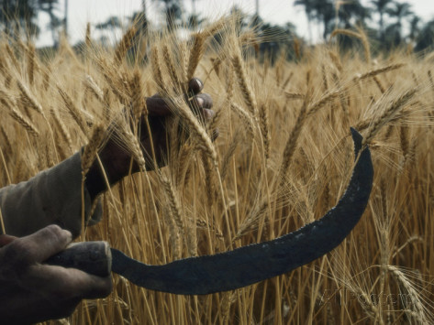
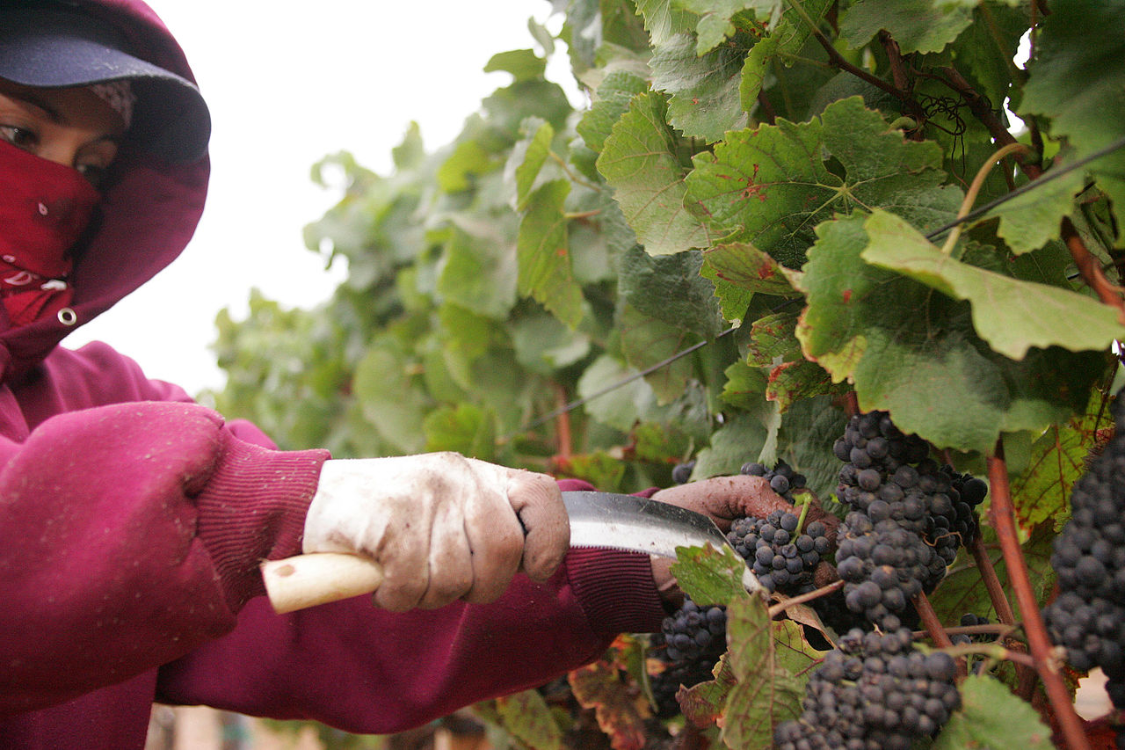
1st 2nd 3rd 4th 5th 6th 7th
SEVEN BEATITUDES OF REVELATION | 1:3 Blessed is the one who reads and Blessed the one who listens | 14:13 Blessed are the dead who die in the Lord from now on | 16:15 Blessed is the one who watches and keeps his clothes ready | 19:9 Blessed are those called to the wedding feast of the Lamb | 20:6 Blessed and holy are those who share in the first resurrection, who will be priests of God and of Christ and will reign with him for a thousand years. | 22:7 Blessed is the one who keeps the prophetic message of this book | 22:14 Blessed are they who wash their robes so as to have the right to the tree of life and enter the city through its gates
10 PLAGUES = 10 PLAGUES OF EGYPT | THE 3 WOES: Plagues: fire, smoke, sulfur |  | HARVEST OF THE JUST |  |  | HARVEST OF THE GRAPES OF GOD’S WRATH POURED LIKE BLOOD UPON THE UNJUST
PLAGUES OF THE BOWLS | Sores on those with mark of beast | Sea turns to blood, all sea creatures die | Rivers and springs turn to blood | On the sun, power to burn people with fire, blasphemers burned | on throne of beast its kingdom in darkness, people bit their tongues and blasphemed | on Euphrates, dries up, unclean spirits come out like frogs from mouth of beast | into air; it is done lightning flashes, earthquake, great city split in 3, wine of wrath, hailstones

Slide 45
Chapter 16
The Seven Bowls. 1I heard a loud voice speaking from the temple to the seven angels, “Go and pour out the seven bowls of God’s fury upon the earth.”
2The first angel went and poured out his bowl on the earth. Festering and ugly sores broke out on those who had the mark of the beast or worshiped its image.
3 The second angel poured out his bowl on the sea. The sea turned to blood like that from a corpse; every creature living in the sea died.
4The third angel poured out his bowl on the rivers and springs of water. These also turned to blood. 5Then I heard the angel in charge of the waters say:
“You are just, O Holy One,
who are and who were,
in passing this sentence.
6For they have shed the blood of the holy ones and the prophets,
and you [have] given them blood to drink;
it is what they deserve.”
7Then I heard the altar cry out,
“Yes, Lord God almighty,
your judgments are true and just.”
8The fourth angel poured out his bowl on the sun. It was given the power to burn people with fire. 9People were burned by the scorching heat and blasphemed the name of God who had power over these plagues, but they did not repent or give him glory.

Slide 46
10 The fifth angel poured out his bowl on the throne of the beast. Its kingdom was plunged into darkness, and people bit their tongues in pain 11and blasphemed the God of heaven because of their pains and sores. But they did not repent of their works.
12The sixth angel emptied his bowl on the great river Euphrates. Its water was dried up to prepare the way for the kings of the East. 13I saw three unclean spirits like frogs come from the mouth of the dragon, from the mouth of the beast, and from the mouth of the false prophet. 14These were demonic spirits who performed signs. They went out to the kings of the whole world to assemble them for the battle on the great day of God the almighty. 15(“Behold, I am coming like a thief.” Blessed is the one who watches and keeps his clothes ready, so that he may not go naked and people see him exposed.) 16They then assembled the kings in the place that is named Armageddon in Hebrew.
17The seventh angel poured out his bowl into the air. A loud voice came out of the temple from the throne, saying, “It is done.” 18Then there were lightning flashes, rumblings, and peals of thunder, and a great earthquake. It was such a violent earthquake that there has never been one like it since the human race began on earth. 19The great city was split into three parts, and the gentile cities fell. But God remembered great Babylon, giving it the cup filled with the wine of his fury and wrath. 20 Every island fled, and mountains disappeared. 21Large hailstones like huge weights came down from the sky on people, and they blasphemed God for the plague of hail because this plague was so severe.

Slide 47
Chapter 17
Babylon the Great. 1 Then one of the seven angels who were holding the seven bowls came and said to me, “Come here. I will show you the judgment on the great harlot who lives near the many waters. 2 The kings of the earth have had intercourse with her, and the inhabitants of the earth became drunk on the wine of her harlotry.” 3Then he carried me away in spirit to a deserted place where I saw a woman seated on a scarlet beast that was covered with blasphemous names, with seven heads and ten horns. 4The woman was wearing purple and scarlet and adorned with gold, precious stones, and pearls. She held in her hand a gold cup that was filled with the abominable and sordid deeds of her harlotry. 5On her forehead was written a name, which is a mystery, “Babylon the great, the mother of harlots and of the abominations of the earth.” 6 I saw that the woman was drunk on the blood of the holy ones and on the blood of the witnesses to Jesus.

Slide 48
Meaning of the Beast and Harlot. When I saw her I was greatly amazed. 7The angel said to me, “Why are you amazed? I will explain to you the mystery of the woman and of the beast that carries her, the beast with the seven heads and the ten horns. 8 The beast that you saw existed once but now exists no longer. It will come up from the abyss and is headed for destruction. The inhabitants of the earth whose names have not been written in the book of life from the foundation of the world shall be amazed when they see the beast, because it existed once but exists no longer, and yet it will come again. 9Here is a clue for one who has wisdom. The seven heads represent seven hills upon which the woman sits. They also represent seven kings: 10five have already fallen, one still lives, and the last has not yet come, and when he comes he must remain only a short while. 11The beast that existed once but exists no longer is an eighth king, but really belongs to the seven and is headed for destruction. 12The ten horns that you saw represent ten kings who have not yet been crowned; they will receive royal authority along with the beast for one hour. 13They are of one mind and will give their power and authority to the beast. 14They will fight with the Lamb, but the Lamb will conquer them, for he is Lord of lords and king of kings, and those with him are called, chosen, and faithful.”
15Then he said to me, “The waters that you saw where the harlot lives represent large numbers of peoples, nations, and tongues. 16The ten horns that you saw and the beast will hate the harlot; they will leave her desolate and naked; they will eat her flesh and consume her with fire. 17For God has put it into their minds to carry out his purpose and to make them come to an agreement to give their kingdom to the beast until the words of God are accomplished. 18The woman whom you saw represents the great city that has sovereignty over the kings of the earth.”

Slide 49
Chapter 18
The Fall of Babylon. 1After this I saw another angel coming down from heaven, having great authority, and the earth became illumined by his splendor. 2 He cried out in a mighty voice:
“Fallen, fallen is Babylon the great.
She has become a haunt for demons.
She is a cage for every unclean spirit,
a cage for every unclean bird,
[a cage for every unclean] and disgusting [beast].
3For all the nations have drunk
the wine of her licentious passion.
The kings of the earth had intercourse with her,
and the merchants of the earth grew rich from her drive for luxury.”
4Then I heard another voice from heaven say:
“Depart from her, my people,
so as not to take part in her sins
and receive a share in her plagues,
5for her sins are piled up to the sky,
and God remembers her crimes.
6Pay her back as she has paid others.
Pay her back double for her deeds.
Into her cup pour double what she poured.

Slide 50
7To the measure of her boasting and wantonness
repay her in torment and grief;
for she said to herself,
‘I sit enthroned as queen;
I am no widow,
and I will never know grief.’
8Therefore, her plagues will come in one day,
pestilence, grief, and famine;
she will be consumed by fire.
For mighty is the Lord God who judges her.”
9The kings of the earth who had intercourse with her in their wantonness will weep and mourn over her when they see the smoke of her pyre. 10They will keep their distance for fear of the torment inflicted on her, and they will say:
“Alas, alas, great city,
Babylon, mighty city.
In one hour your judgment has come.”
11The merchants of the earth will weep and mourn for her, because there will be no more markets for their cargo: 12their cargo of gold, silver, precious stones, and pearls; fine linen, purple silk, and scarlet cloth; fragrant wood of every kind, all articles of ivory and all articles of the most expensive wood, bronze, iron, and marble; 13cinnamon, spice, incense, myrrh, and frankincense; wine, olive oil, fine flour, and wheat; cattle and sheep, horses and chariots, and slaves, that is, human beings.

Slide 51
14“The fruit you craved
has left you.
All your luxury and splendor are gone,
never again will one find them.”
15The merchants who deal in these goods, who grew rich from her, will keep their distance for fear of the torment inflicted on her. Weeping and mourning, 16they cry out:
“Alas, alas, great city,
wearing fine linen, purple and scarlet,
adorned [in] gold, precious stones, and pearls.
17In one hour this great wealth has been ruined.”
Every captain of a ship, every traveler at sea, sailors, and seafaring merchants stood at a distance 18and cried out when they saw the smoke of her pyre, “What city could compare with the great city?” 19 They threw dust on their heads and cried out, weeping and mourning:
“Alas, alas, great city,
in which all who had ships at sea
grew rich from her wealth.
In one hour she has been ruined.
20Rejoice over her, heaven,
you holy ones, apostles, and prophets.
For God has judged your case against her.”

Slide 52
21A mighty angel picked up a stone like a huge millstone and threw it into the sea and said:
“With such force will Babylon the great city be thrown down,
and will never be found again.
22No melodies of harpists and musicians,
flutists and trumpeters,
will ever be heard in you again.
No craftsmen in any trade
will ever be found in you again.
No sound of the millstone
will ever be heard in you again.
23No light from a lamp
will ever be seen in you again.
No voices of bride and groom
will ever be heard in you again.
Because your merchants were the great ones of the world,
all nations were led astray by your magic potion.
24In her was found the blood of prophets and holy ones
and all who have been slain on the earth.”

Slide 53
Chapter 19
1After this I heard what sounded like the loud voice of a great multitude in heaven, saying:
“Alleluia!
Salvation, glory, and might belong to our God,
2for true and just are his judgments.
He has condemned the great harlot
who corrupted the earth with her harlotry.
He has avenged on her the blood of his servants.”
3They said a second time:
“Alleluia! Smoke will rise from her forever and ever.”
4The twenty-four elders and the four living creatures fell down and worshiped God who sat on the throne, saying, “Amen. Alleluia.”

Slide 54
The Victory Song. 5A voice coming from the throne said:
“Praise our God, all you his servants,
[and] you who revere him, small and great.”
6Then I heard something like the sound of a great multitude or the sound of rushing water or mighty peals of thunder, as they said:
“Alleluia!
The Lord has established his reign,
[our] God, the almighty.
7Let us rejoice and be glad
and give him glory.
For the wedding day of the Lamb has come,
his bride has made herself ready.
8She was allowed to wear
a bright, clean linen garment.”
(The linen represents the righteous deeds of the holy ones.)
9Then the angel said to me, “Write this: Blessed are those who have been called to the wedding feast of the Lamb.” And he said to me, “These words are true; they come from God.” 10I fell at his feet to worship him. But he said to me, “Don’t! I am a fellow servant of yours and of your brothers who bear witness to Jesus. Worship God. Witness to Jesus is the spirit of prophecy.”

Slide 55
The King of Kings. 11 Then I saw the heavens opened, and there was a white horse; its rider was [called] “Faithful and True.” He judges and wages war in righteousness. 12His eyes were [like] a fiery flame, and on his head were many diadems. He had a name inscribed that no one knows except himself. 13He wore a cloak that had been dipped in blood, and his name was called the Word of God. 14The armies of heaven followed him, mounted on white horses and wearing clean white linen. 15Out of his mouth came a sharp sword to strike the nations. He will rule them with an iron rod, and he himself will tread out in the wine press the wine of the fury and wrath of God the almighty. 16He has a name written on his cloak and on his thigh, “King of kings and Lord of lords.”
17 Then I saw an angel standing on the sun. He cried out [in] a loud voice to all the birds flying high overhead, “Come here. Gather for God’s great feast, 18to eat the flesh of kings, the flesh of military officers, and the flesh of warriors, the flesh of horses and of their riders, and the flesh of all, free and slave, small and great.” 19Then I saw the beast and the kings of the earth and their armies gathered to fight against the one riding the horse and against his army. 20The beast was caught and with it the false prophet who had performed in its sight the signs by which he led astray those who had accepted the mark of the beast and those who had worshiped its image. The two were thrown alive into the fiery pool burning with sulfur. 21The rest were killed by the sword that came out of the mouth of the one riding the horse, and all the birds gorged themselves on their flesh.

Slide 56
Chapter 20
The Thousand-year Reign. 1 Then I saw an angel come down from heaven, holding in his hand the key to the abyss and a heavy chain. 2He seized the dragon, the ancient serpent, which is the Devil or Satan, and tied it up for a thousand years 3and threw it into the abyss, which he locked over it and sealed, so that it could no longer lead the nations astray until the thousand years are completed. After this, it is to be released for a short time.
4Then I saw thrones; those who sat on them were entrusted with judgment. I also saw the souls of those who had been beheaded for their witness to Jesus and for the word of God, and who had not worshiped the beast or its image nor had accepted its mark on their foreheads or hands. They came to life and they reigned with Christ for a thousand years. 5The rest of the dead did not come to life until the thousand years were over. This is the first resurrection. 6Blessed and holy is the one who shares in the first resurrection. The second death has no power over these; they will be priests of God and of Christ, and they will reign with him for [the] thousand years.
7 When the thousand years are completed, Satan will be released from his prison. 8He will go out to deceive the nations at the four corners of the earth, Gog and Magog, to gather them for battle; their number is like the sand of the sea. 9They invaded the breadth of the earth and surrounded the camp of the holy ones and the beloved city. But fire came down from heaven and consumed them. 10The Devil who had led them astray was thrown into the pool of fire and sulfur, where the beast and the false prophet were. There they will be tormented day and night forever and ever.

Slide 57
The Large White Throne. 11Next I saw a large white throne and the one who was sitting on it. The earth and the sky fled from his presence and there was no place for them. 12I saw the dead, the great and the lowly, standing before the throne, and scrolls were opened. Then another scroll was opened, the book of life. The dead were judged according to their deeds, by what was written in the scrolls. 13The sea gave up its dead; then Death and Hades gave up their dead. All the dead were judged according to their deeds. 14 Then Death and Hades were thrown into the pool of fire. (This pool of fire is the second death.) 15Anyone whose name was not found written in the book of life was thrown into the pool of fire.

Slide 58
Chapter 21
The New Heaven and the New Earth. 1 Then I saw a new heaven and a new earth. The former heaven and the former earth had passed away, and the sea was no more. 2I also saw the holy city, a new Jerusalem, coming down out of heaven from God, prepared as a bride adorned for her husband. 3I heard a loud voice from the throne saying, “Behold, God’s dwelling is with the human race. He will dwell with them and they will be his people and God himself will always be with them [as their God]. 4He will wipe every tear from their eyes, and there shall be no more death or mourning, wailing or pain, [for] the old order has passed away.”
5The one who sat on the throne said, “Behold, I make all things new.” Then he said, “Write these words down, for they are trustworthy and true.” 6He said to me, “They are accomplished. I [am] the Alpha and the Omega, the beginning and the end. To the thirsty I will give a gift from the spring of life-giving water. 7The victor will inherit these gifts, and I shall be his God, and he will be my son. 8But as for cowards, the unfaithful, the depraved, murderers, the unchaste, sorcerers, idol-worshipers, and deceivers of every sort, their lot is in the burning pool of fire and sulfur, which is the second death.”
The New Jerusalem. 9One of the seven angels who held the seven bowls filled with the seven last plagues came and said to me, “Come here. I will show you the bride, the wife of the Lamb.” 10He took me in spirit to a great, high mountain and showed me the holy city Jerusalem coming down out of heaven from God. 11It gleamed with the splendor of God. Its radiance was like that of a precious stone, like jasper, clear as crystal. 12It had a massive, high wall, with twelve gates where twelve angels were stationed and on which names were inscribed, [the names] of the twelve tribes of the Israelites. 13There were three gates facing east, three north, three south, and three west. 14The wall of the city had twelve courses of stones as its foundation, on which were inscribed the twelve names of the twelve apostles of the Lamb.

Slide 59
15 The one who spoke to me held a gold measuring rod to measure the city, its gates, and its wall. 16The city was square, its length the same as [also] its width. He measured the city with the rod and found it fifteen hundred miles in length and width and height. 17He also measured its wall: one hundred and forty-four cubits according to the standard unit of measurement the angel used. 18 The wall was constructed of jasper, while the city was pure gold, clear as glass. 19The foundations of the city wall were decorated with every precious stone; the first course of stones was jasper, the second sapphire, the third chalcedony, the fourth emerald, 20the fifth sardonyx, the sixth carnelian, the seventh chrysolite, the eighth beryl, the ninth topaz, the tenth chrysoprase, the eleventh hyacinth, and the twelfth amethyst. 21The twelve gates were twelve pearls, each of the gates made from a single pearl; and the street of the city was of pure gold, transparent as glass.
22 I saw no temple in the city, for its temple is the Lord God almighty and the Lamb. 23 The city had no need of sun or moon to shine on it, for the glory of God gave it light, and its lamp was the Lamb. 24The nations will walk by its light, and to it the kings of the earth will bring their treasure. 25During the day its gates will never be shut, and there will be no night there. 26The treasure and wealth of the nations will be brought there, 27but nothing unclean will enter it, nor any[one] who does abominable things or tells lies. Only those will enter whose names are written in the Lamb’s book of life.

Slide 60
Chapter 22
1Then the angel showed me the river of life-giving water, sparkling like crystal, flowing from the throne of God and of the Lamb 2down the middle of its street. On either side of the river grew the tree of life that produces fruit twelve times a year, once each month; the leaves of the trees serve as medicine for the nations. 3Nothing accursed will be found there anymore. The throne of God and of the Lamb will be in it, and his servants will worship him. 4They will look upon his face, and his name will be on their foreheads. 5Night will be no more, nor will they need light from lamp or sun, for the Lord God shall give them light, and they shall reign forever and ever.

Slide 61
VII. EPILOGUE
6And he said to me, “These words are trustworthy and true, and the Lord, the God of prophetic spirits, sent his angel to show his servants what must happen soon.” 7 “Behold, I am coming soon.” Blessed is the one who keeps the prophetic message of this book.
8It is I, John, who heard and saw these things, and when I heard and saw them I fell down to worship at the feet of the angel who showed them to me. 9But he said to me, “Don’t! I am a fellow servant of yours and of your brothers the prophets and of those who keep the message of this book. Worship God.”
10Then he said to me, “Do not seal up the prophetic words of this book, for the appointed time is near. 11Let the wicked still act wickedly, and the filthy still be filthy. The righteous must still do right, and the holy still be holy.”

Slide 62
12“Behold, I am coming soon. I bring with me the recompense I will give to each according to his deeds. 13I am the Alpha and the Omega, the first and the last, the beginning and the end.”
14Blessed are they who wash their robes so as to have the right to the tree of life and enter the city through its gates. 15Outside are the dogs, the sorcerers, the unchaste, the murderers, the idol-worshipers, and all who love and practice deceit.
16“I, Jesus, sent my angel to give you this testimony for the churches. I am the root and offspring of David, the bright morning star.”
17The Spirit and the bride say, “Come.” Let the hearer say, “Come.” Let the one who thirsts come forward, and the one who wants it receive the gift of life-giving water.
18I warn everyone who hears the prophetic words in this book: if anyone adds to them, God will add to him the plagues described in this book, 19and if anyone takes away from the words in this prophetic book, God will take away his share in the tree of life and in the holy city described in this book.
20 The one who gives this testimony says, “Yes, I am coming soon.” Amen! Come, Lord Jesus!
21The grace of the Lord Jesus be with all.

